Slide 1
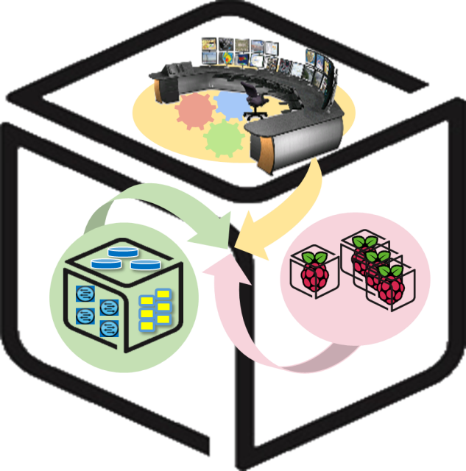



Computer Systems
For AI-inspired Cloud
Theory & Lab.
Lab #1: Box
https://github.com/SmartX-Labs/SmartX-Mini-MOOC

Slide 2






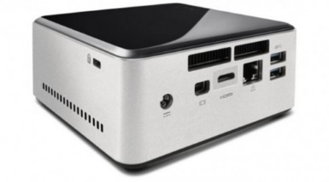
Box Lab: Outline
VM
Container
Tap1
ping test
br0
eno1

Slide 3


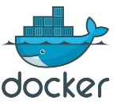

Box Lab: Final Goal
VM

Slide 4

Before you start
- Things you need to know
Lab Theory
Lab
Practice
Lectures are divided into Lab Theory, Lab Practice and Lab Review parts.
Lab
Review
The keyboard means that you should execute instructions by following the guidance.

Slide 5



Lab Theory

Slide 6

Linux Box with Virtualization/Containers
VM
Container
Tap1
ping test
Virtual Machine
&
Container
br0
eno1
Linux Box

Slide 7
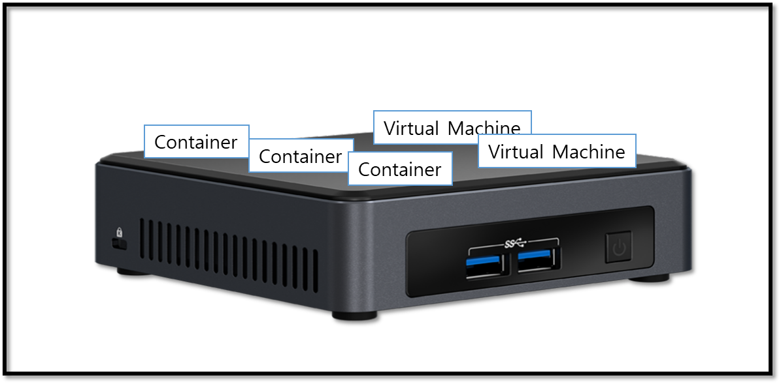
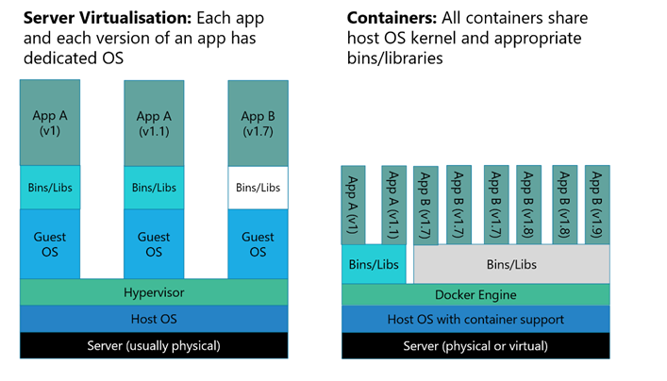

VMs and Containers on a Linux Box
On a Linux Box (e.g., NUC)
Multiple fully-isolated (with dedicated resources), but heavy VM instances (i.e., VMs).
Multiple partially-isolated, lightweight container instances (i.e., containers)
Virtual Machines (VMs)
Containers
Heavier than
Container!
Hypervisor Tool for creating VMs
Container Runtime Tool for running containers

Slide 8

A Switch inside Linux Box: Open vSwitch
VM
Container
Tap1
ping test
br0
eno1

Slide 9
Virtual Switch in a Box to connect VMs
Hypervisor
VM
VM
VM
VM
Linux Box
Virtual NIC
Virtual interface
Virtual switch
Virtual L2 network
Physical switch
L2 network
A software-based virtual switch allows one VM to communicate with neighbor VMs as well as to connect to Internet (via physical switch).
Software-based switches (running with the power of CPUs) are known to be more flexible/upgradable and benefited of virtualization (memory overcommit, page sharing, …)
VMs (similarly containers) have logical (virtual) NIC with virtual Ethernet ports so that they can be plugged into the virtual interface (port) of virtual switches.

Slide 10

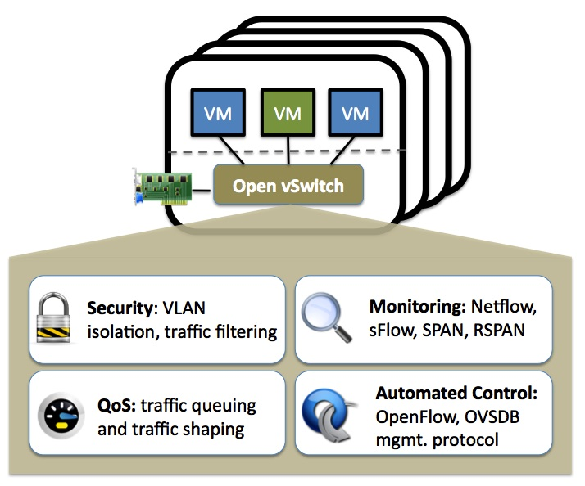
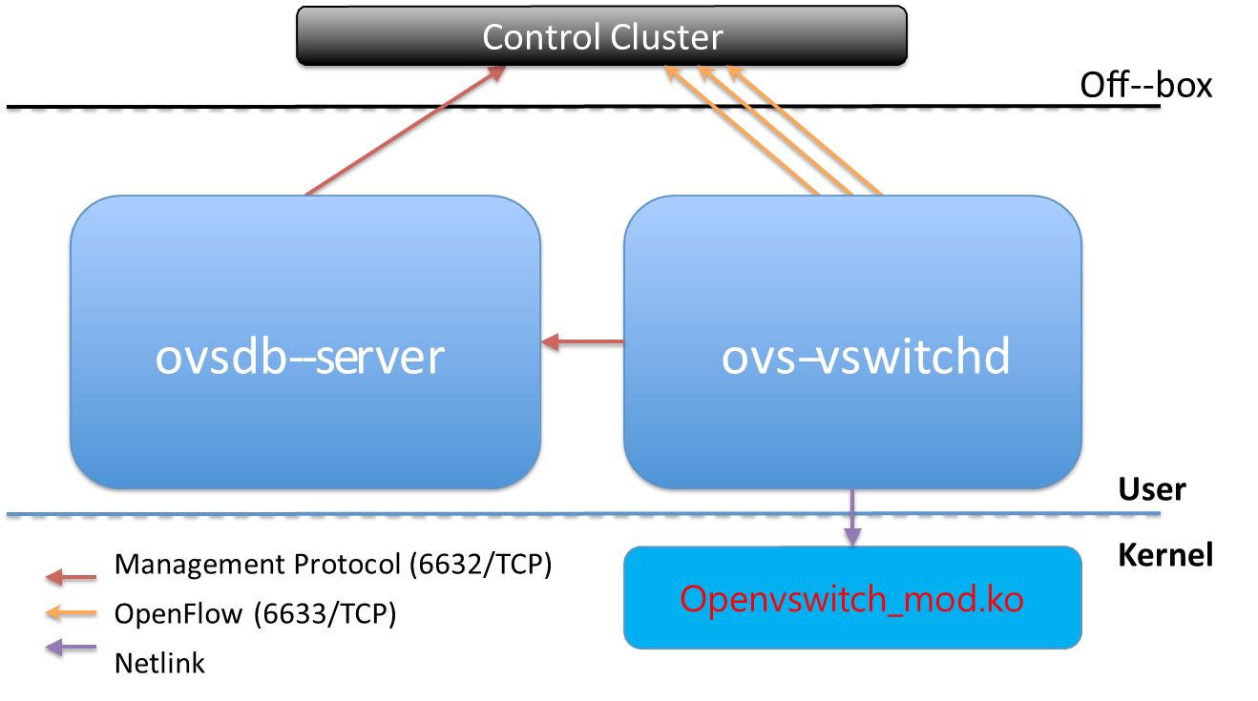
Linux-adopted virtual switch: Open vSwitch
http://openvswitch.org/
Open vSwitch is an open-source virtual switch software designed for virtual servers.
OVS Main components

Slide 11
Lab Practice

Slide 12
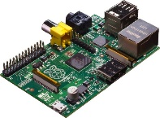
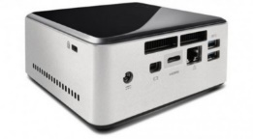


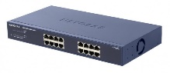
NAME: NUC5i5MYHE (NUC PC) CPU: i5-5300U @2.30GHz CORE: 4 Memory: 16GB DDR3 HDD: 94GB
#0 - Lab Preparation
Wired connection
NAME: Raspberry Pi Model B (Pi) CPU: ARM Cortex A7 @900MHz CORE: 4 Memory: 1GB SD Card: 32GB
NAME: NT900X3A
CPU: i5-2537U @1.40GHz
CORE: 2 Memory: 4GB DDR3 HDD: 128GB
NAME: netgear prosafe 16 port gigabit switch(Switch) Network Ports: 16 auto-sensing 10/100/1000 Mbps Ethernet ports

Slide 13

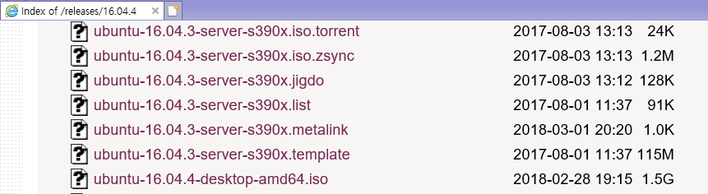
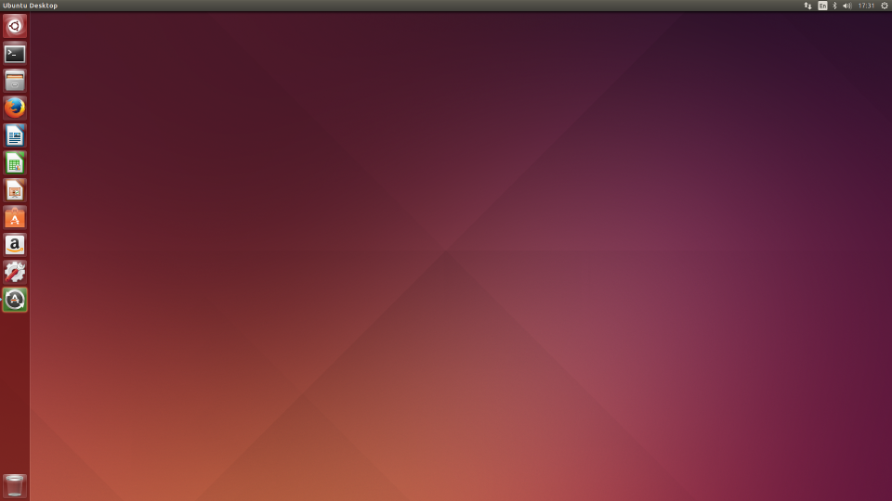
#1 - NUC: OS Installation
OS : Ubuntu Desktop 18.04 LTS(64bit)
Download Site : http://old-releases.ubuntu.com/releases/bionic/
Bootable USB configuration (no bootable CD, no CD-Rom in NUC) using the downloaded file (ubuntu-16.04.4-desktop-amd64.iso, 1.5Gb)
Installed on NUC
Ubuntu Home Screen After Installation

Slide 14
#2 - NUC: Network Configuration (1/3)
VM
Container
Tap1
ping test
br0
eno1

Slide 15
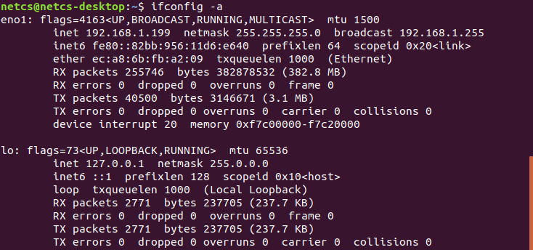
#2 - NUC: Network Configuration (1/3)
- Network interface
$sudo apt update
$sudo apt upgrade
$sudo apt install net-tools
$ifconfig –a

Slide 16
#2 - NUC: Network Configuration (1/3)
- Network interface (공유기 쓰는 학생들)
$sudo apt install ifupdown
$sudo vi /etc/network/interfaces
----------------- /etc/network/interfaces -----------------
auto lo
iface lo inet loopback
auto eno1
iface eno1 inet static
address 192.168.0.6
netmask 255.255.255.0
gateway 192.168.0.1
dns-nameservers [nameserver 1] [nameserver 2]
----------------------------------------------------------------------------
Some NUC have different Interface name.
So you need to check your NUC’s interface name using
‘ip a’ command.

Slide 17
#2 - NUC: Network Configuration (1/3)
- Network interface (공유기 안쓰는 학생들 - 기숙사)
$sudo apt install ifupdown
$sudo vi /etc/network/interfaces
----------------- /etc/network/interfaces -----------------
auto lo
iface lo inet loopback
auto eno1
iface eno1 inet static
address 210.XXX.XXX.XXX
netmask 255.255.255.0
gateway 210.xxx.xxx.xxx
dns-nameservers 8.8.8.8
----------------------------------------------------------------------------
Some NUC have different Interface name.
So you need to check your NUC’s interface name using
‘ip a’ command.
<- Input your dorm. room’s IP address
<- Input your dorm. room’s gateway
<- Input your dorm. room’s dns-nameservers

Slide 18
#2 - NUC: Network Configuration (1/3)
- Network interface (공유기 안쓰는 학생들 - 실험실)
$sudo apt install ifupdown
$sudo vi /etc/network/interfaces
----------------- /etc/network/interfaces -----------------
auto lo
iface lo inet loopback
auto eno1
iface eno1 inet static
address 172.XXX.XXX.XXX
netmask 255.255.255.0
gateway 172.xxx.x.x
dns-nameservers 8.8.8.8
----------------------------------------------------------------------------
Some NUC have different Interface name.
So you need to check your NUC’s interface name using
‘ip a’ command.
<- Input your given IP address
<- Input your given gateway
<- Input your given dns-nameservers

Slide 19
#2 - NUC: Network Configuration (1/3)
- Network interface
$ sudo su
#ifdown --force enp0s3 lo && ifup -a
#systemctl unmask networking
#systemctl enable networking
#systemctl restart networking
Disable netplan
#systemctl stop systemd-networkd.socket systemd-networkd \
networkd-dispatcher systemd-networkd-wait-online
#systemctl disable systemd-networkd.socket systemd-networkd \
networkd-dispatcher systemd-networkd-wait-online
#systemctl mask systemd-networkd.socket systemd-networkd \
networkd-dispatcher systemd-networkd-wait-online
#apt-get --assume-yes purge nplan netplan.io
#exit

Slide 20
#2 - NUC: Network Configuration (1/3)
- eno1 interface
$ sudo vi /etc/systemd/resolved.conf
----------------- /etc/systemd/resolved.conf -----------------
…
DNS = 8.8.8.8 8.8.4.4
…
----------------------------------------------------------------------------
$sudo systemctl restart systemd-resolved.service
$sudo ifup eno1
Your Box
NUC internet works!
eno1
<Your ip addr>

Slide 21
#3 - NUC: OVS installation
VM
Container
Tap1
ping test
br0
eno1

Slide 22
#3 - NUC: OVS installation
- Update installation of OVS package
Update index information of Open vSwitch package.
Install a Open vSwitch package, openvswitch-switch.
Other dependencies are automatically installed.
$sudo apt update
$sudo apt install openvswitch-switch

Slide 23
#4 - NUC: Network Configuration (2/3)
VM
Container
Tap1
ping test
br0
eno1

Slide 24
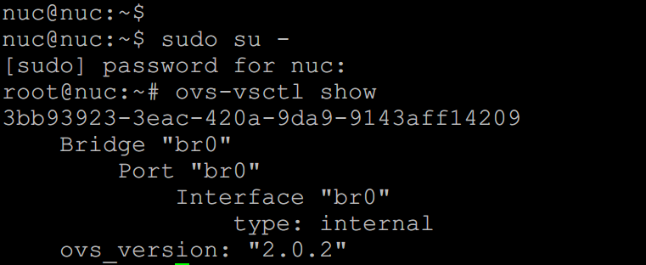
#4 - NUC: Network Configuration (2/3)
- Connect OVS br0 and NUC eno1 via OVS
$sudo ovs-vsctl add-br br0

Slide 25
KVM-based VM connected via OVS
- Goal of this section
VM

Slide 26
#5 - NUC: Network Configuration (3/3)
VM
Container
[Tap_name]
vport_vFunction
Tap0
ping test
br0
eno1

Slide 27
#5 - NUC: Network Configuration (3/3)
- Connect OVS tap0 & br0 through OVS
Let’s make a tap interface and attach it to your VM.
$sudo vi /etc/network/interfaces
----------------- /etc/network/interfaces -----------------
…
(Append the lines below to the config file)
auto vport_vFunction
iface vport_vFunction inet manual
pre-up ip tuntap add vport_vFunction mode tap
up ip link set dev vport_vFunction up
post-down ip link del dev vport_vFunction
auto br0
iface br0 inet manual
address 192.168.100.1
netmask 255.255.255.0

Slide 28
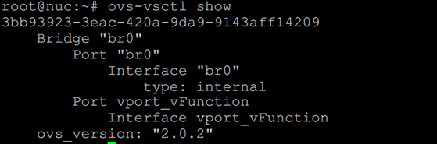
#5 - NUC: Network Configuration (3/3)
-Connect vport_vFunction, br0 through OVS
Turn on the tap interface and attach it to br0.
$sudo ifup vport_vFunction
$sudo ifup br0
$sudo ovs-vsctl add-port br0 vport_vFunction // Turn on and attach to br0
We should make VM attaching vport_vFunction. You can think this tap as a NIC of VM.
Your Box
VM
192.168.x.x
vport_vFunction
br0
192.168.100.1
[tap_name]
eno1
Your ip addr

Slide 29
#6 - NUC: Making VM with KVM
VM
Container
[Tap_name]
vport_vFunction
Tap0
ping test
br0
eno1

Slide 30
#6 - NUC: Making VM with KVM
-Install dependency to upgrade KVM
Install dependency & download Ubuntu 16.04.4 64bit server image.
$sudo apt-get install qemu-kvm libvirt-bin //upgrade KVM //qemu is open-source emulator
$wget http://old-releases.ubuntu.com/releases/16.04.4/ubuntu-16.04.4-server-amd64.iso
Now we are ready to make VM. So continue the setting.

Slide 31
#6 - NUC: Making VM with KVM
-Prepare for Ubuntu VM
Make a VM image.
$sudo qemu-img create [img_name].img -f qcow2 [storage_capacity]
$sudo qemu-img create vFunction20.img -f qcow2 10G
Result..
Boot VM image from Ubuntu iso file (mac should be different from others).
$sudo kvm -m [memory_capacity] -name [vm_name] -smp cpus=[#cpu],maxcpus= [#maxcpu] -device virtio-net-pci,netdev=net0,mac= [EE:EE:EE:EE:EE:EE] -netdev tap,id=net0,ifname= [tap_name],script=no -boot d [img_name].img -cdrom ubuntu-16.04.4-server-amd64.iso -vnc :[#] –daemonize -monitor telnet:127.0.0.1:3010,server,nowait,ipv4
$ sudo kvm -m 512 -name tt -smp cpus=2,maxcpus=2 -device virtio-net-pci,netdev=net0 -netdev tap,id=net0,ifname=vport_vFunction,script=no -boot d vFunction20.img -cdrom ubuntu-16.04.4-server-amd64.iso -vnc :5 -daemonize -monitor telnet:127.0.0.1:3010,server,nowait,ipv4
Install VNC viewer and see inside of VM
$sudo apt-get install xvnc4viewer
$xvnc4viewer localhost :5

Slide 32
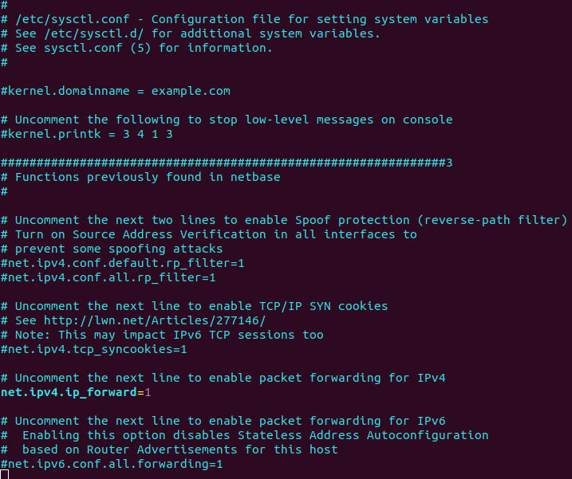
#6 - NUC: Making VM with KVM
-Prepare for Ubuntu VM
Configure SNAT with iptables for VM network
$sudo iptables –A FORWARD –i eno1 –j ACCEPT
$sudo iptables –A FORWARD –o eno1 –j ACCEPT
$sudo iptables –t nat –A POSTROUTING –s 192.168.100.0/24 \
–o eno1 –j SNAT --to <Your ip address>
$vi /etc/sysctl.conf
#net.ipv4.ip_forward=1
net.ipv4.ip_forward=1
$sysctl –p
net.ipv4.ip_forward = 1
Configuration complete

Slide 33
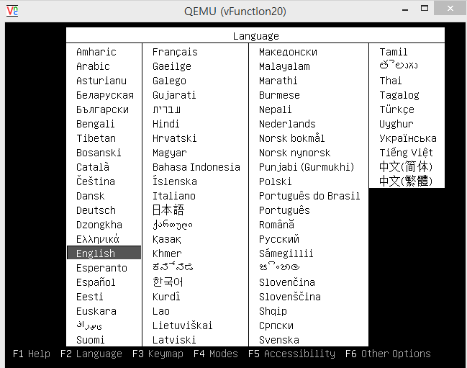
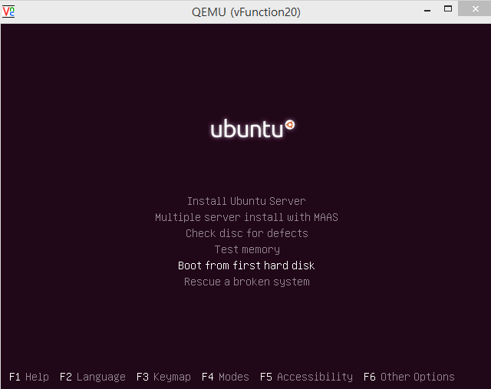
#6 - NUC: Making VM with KVM
-Install Ubuntu VM

Slide 34
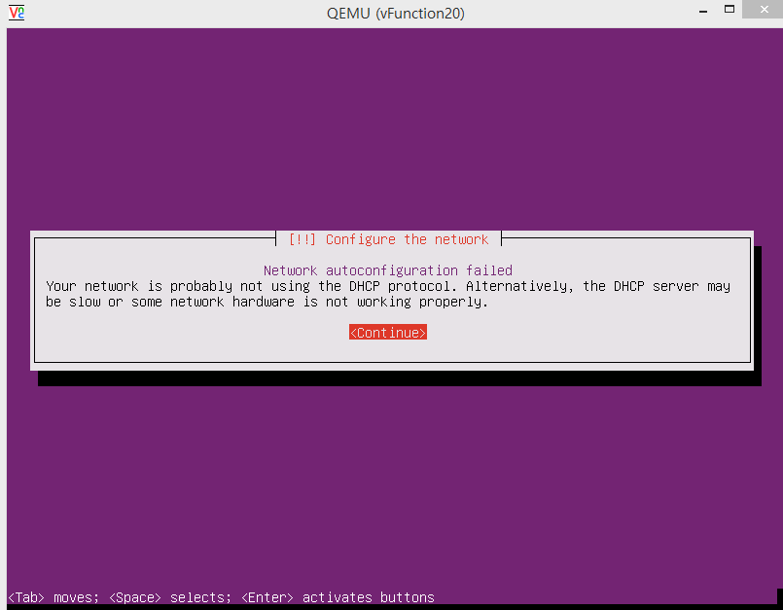

Slide 35
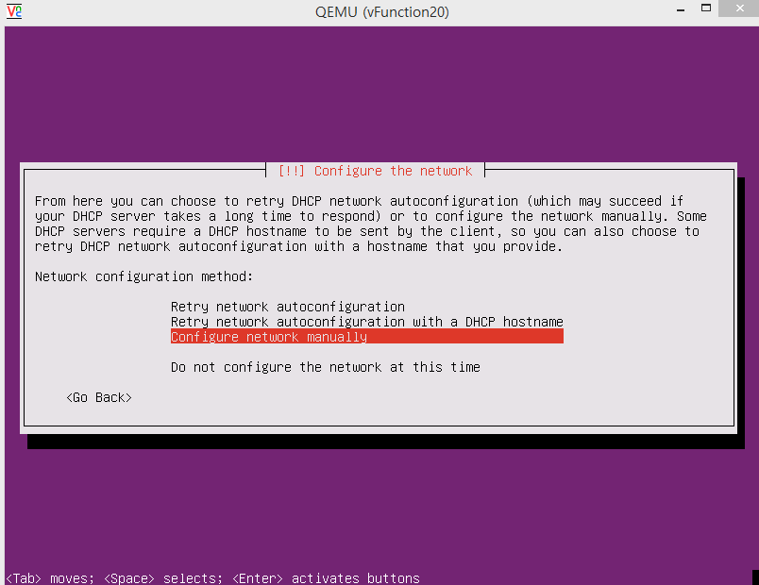

Slide 36
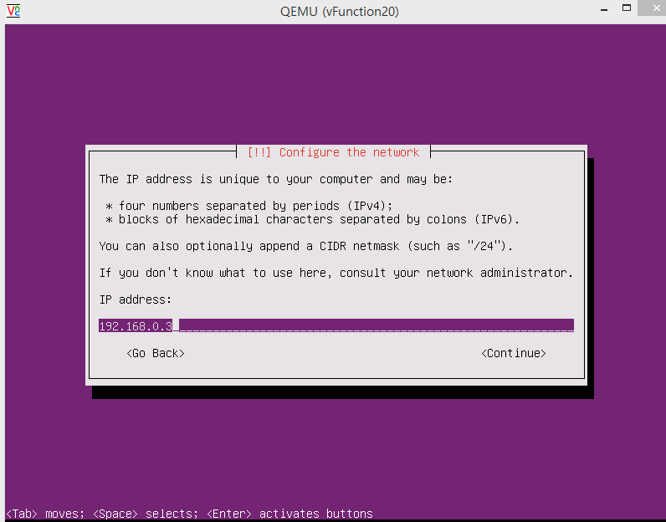
private address
192.168.100.2

Slide 37
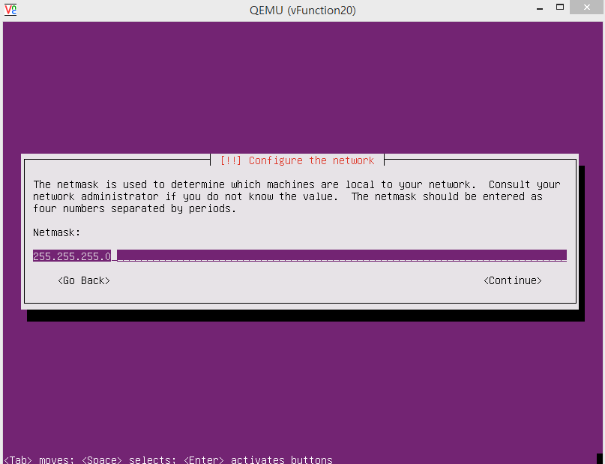

Slide 38
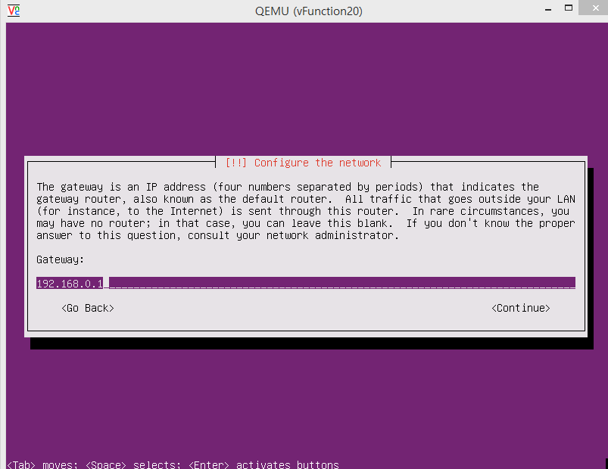
Gateway ip of your private network
192.168.100.1

Slide 39
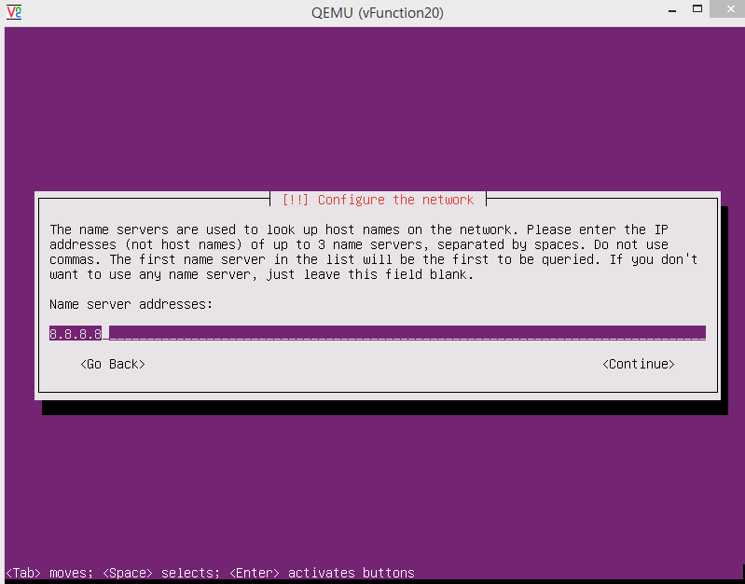
Google DNS server

Slide 40
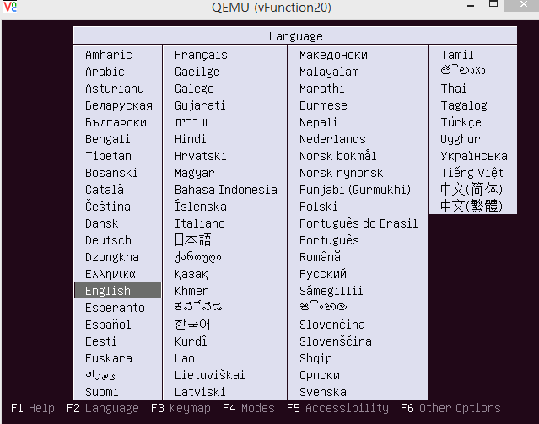
#6 - NUC: Making VM with KVM
- Eject Ubuntu install image
After installing Ubuntu Linux on the VM….
You need to eject Ubuntu install image before booting to the installed OS
$telnet localhost 3010
Trying 127.0.0.1...
Connected to localhost.Escape character is '^]‘ (Ctrl+]).
QEMU 0.11.0 monitor - type 'help' for more information
(qemu) eject ide1-cd0
(qemu) Ctrl+]
$ xvnc4viewer localhost :5
Push Esc

Slide 41
#7 - NUC: Booting VM
- VM boot command
If you want boot VM again (mac should be different from others).
$sudo kvm -m [memory capacity] -name [name] -smp cpus=[#cpu],maxcpus= [#maxcpu] -device virtio-net-pci,netdev=net0,mac= [EE:EE:EE:EE:EE:EE] –netdev tap,id=net0,ifname= [tap_name],script=no -boot d [name].img -vnc : [#] -daemonize

Slide 42
#8 - OVS connects with KVM
- Check situation
VM
ip : 192.168.100.2
tap_name
br0
ip : 192.168.100.1
eno1
ip : <Your ip address>

Slide 43
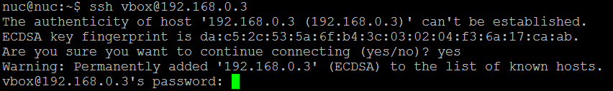
#9 - NUC: Installing ssh in VM
- Don’t forget to install ssh in VM
In VMs,
$sudo apt-get update
$sudo apt-get install net-tools ssh -y

Slide 44
Docker Container connected via OVS
- Goal of this section

Slide 45
#10 - Making a Docker Container
VM
Container
Tap0
ping test
br0
eno1

Slide 46
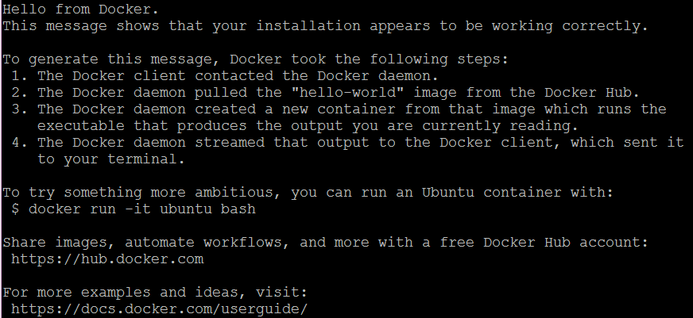
#10 - Making a Docker Container
- Docker installation
Docker installation.
$sudo wget -qO- https://get.docker.com/ | sh
$sudo systemctl start docker
$sudo adduser [Your_account] docker
(Session restart)
$sudo docker run hello-world
reference: http://docs.docker.com/linux/step_one/

Slide 47
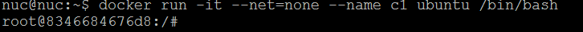
#10 - Making a Docker Container
- Make container
Run docker container.
$sudo docker run -it --net=none --name [container_name] ubuntu /bin/bash
※ctrl + p, q → detach docker container
※docker attach [container_name] → get into docker container console

Slide 48
#11 - Connect Docker Container
- Connect with OVS bridge
VM
Container
Tap0
ping test
br0
eno1

Slide 49
#11 - Connect docker Container
- Connect with OVS bridge
Install OVS-docker utility in host machine. (Not in inside of Docker container.)
$sudo ovs-docker add-port br0 eno2 [container_name] --ipaddress=192.168.100.3/24 --gateway=192.168.100.1
$sudo docker attach [container_name]
#apt-get update
#apt-get install net-tools
#apt-get install iputils-ping

Slide 50
#12 – Keep Docker network configuration
- /etc/rc.local
Modify /etc/rc.local
$sudo vi /etc/rc.local
docker start [container_name]
OVS-docker del-port br0 eno1 [containerName]
OVS-docker add-port br0 eno1 [containerName] --ipaddress=[IP_address/24] --gateway=[Gateway_address]
Whenever NUC is rebooted,
network configuration of Docker container is initialized
by executing commands in rc.local

Slide 51
#13 – Check connectivity: VM & Container
VM
Container
Tap0
ping test
br0
eno1

Slide 52


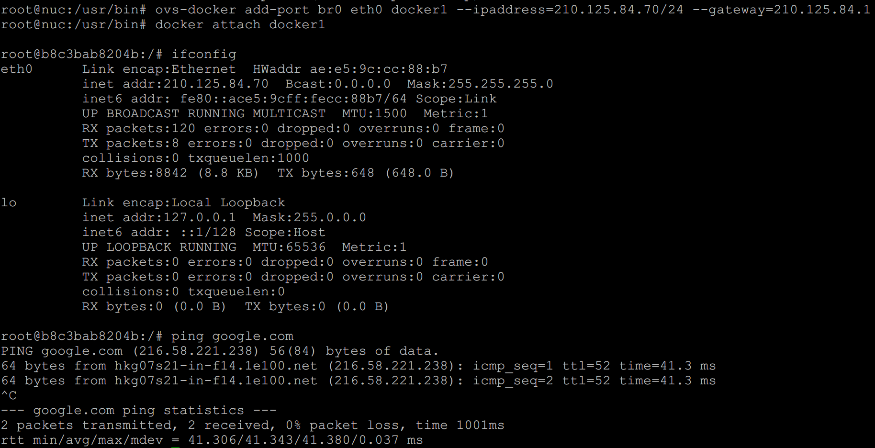
#13 - Check connectivity: VM & Container
-Check connectivity with ping command

Slide 53
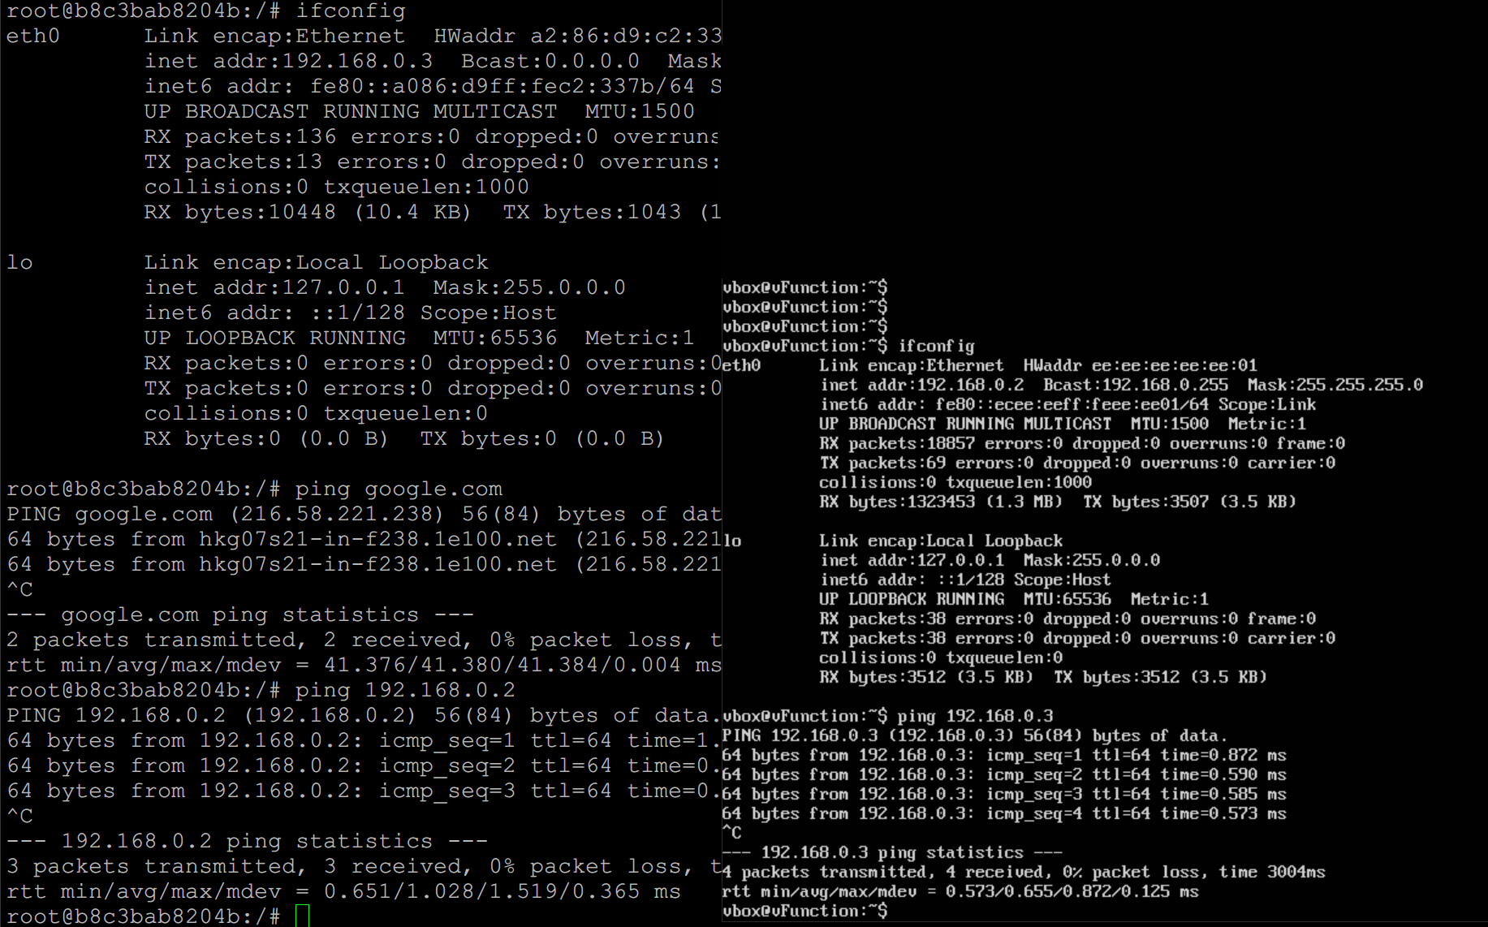
#13 - Check connectivity: VM & Container
-Check connectivity with ping command
Docker container
KVM VM

Slide 54
Box Lab: Final Goal (Recap)
VM

Slide 55
Lab Review

Slide 56
Lab Summary
With Box Lab, you have experimented
How to install and configure Linux OS into Box (i.e., computer).
How to install and configure OVS (Open vSwitch) virtual switch inside a Linux Box and configure it.
How to create VMs and Docker containers inside a Linux Box and then inter-connect each of them together and to the Internet.

Slide 57
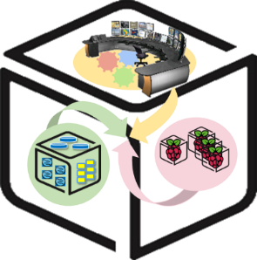
Thank You for Your Attention
Any Questions?
mini@smartx.kr

